Slide 1
Loading & Best Practices

Slide 2
Loading Data
We can specify whole directories, use wildcards, etc:
sc.textFile("/my/dir1,/my/paths/part-00[0-5]*,/another/dir,/a/specific/file")
When you have a large file that cannot be spit then it is read all at once by one executor and you only get 1 spark task. Hence, there is need to call repartition there, otherwise all transformations downstream will also only use one task.
However, this shouldn’t be a problem with modern file formats and tools, you should be able to and do split huge files. e.g., if you compress Parquet files with Snappy they are splittable.

Slide 3
Loading Data
Ideal case is all files can fit into executor cache. But may not always be feasible.
If not, at least split the files to take advantage of the parallelism of multiple executors.
PS: Each executor has memory overhead ~ 10% of allocated memory or minimum of 384 MB.

Slide 4
Loading Data - Too Many Files
In hadoop many small sizes -> pointer for each file -> might run into mem issues on name node.
Also, if block size bigger than file size – not good it’ll make a block size for each file.
In S3 many small files -> higher cost many put and get requests -> aws charges per.

Slide 5
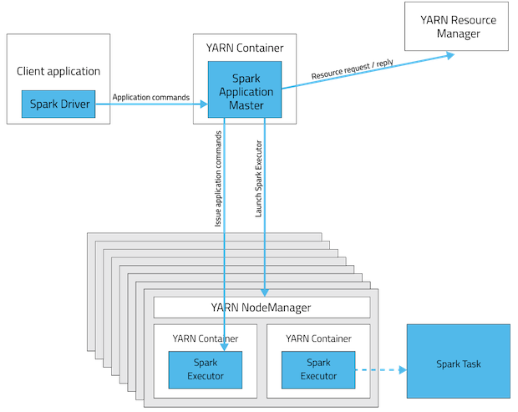
Example on YARN

Slide 6
Example on YARN
An example of configuring a spark app to use as much of the clusters as possible
Give a cluster with 6 nodes with 16 cores and 64GB of memory each:
yarn.nodemanager.resource.memory-mb = 63*1024
yarn.nodemanager.resource.cpu-vcores = 15
This leave 1GB and 1 core for system processes
Spark Config to utilize max resources?
--num-executors 17 --executor-cores 5 --executor-memory 19G
Notes:
Explanation of the solution
--executor-cores 5
This is set to 5 as suggested from the previous slide
--num-executors 17
Each node has 15 available cores
Using suggested 5 cores per executor results in each machine hosting 3 executors
Cluster has 6*3 = 18 slots for executors, but the Application Master needs CPU to run as well, so the reduce by 1 to get 17
--executor-memory
With 3 executors per node and a total allocatable 63GB per node (as set by yarn.nodemanager.resource.memory-mb), the max possible memory for each executor is 63/3 = 21GB
Knowing that YARN will round up the memory resource allocation, it is useful to specify the memory to be 90% of the max: 21GB *.9 = ~19GB

Slide 7
Other observations
Configuring for at most 5 threads (executor cores) per executor can achieve full write throughput.
Running executors with too much memory results in excess garbage collection. 64GB is a good upper limit for a single executor.

Slide 8
Parallelism
RDDs produced by textFile or hadoopFile have the number of partitions determined by the underlying MapReduce InputFormat that is used (number of files)
Typically there will be a partition for each HDFS block being read
Partitions for RDDs produced by parallelize come from the parameter given by the user or by spark.default.parallelism
To determine the number of partitions in an RDD you can call rdd.partitions().size() or df.rdd.getNumPartitions()

Slide 9
Parallelism
To increase parallelism, increase the number of partitions
If the stage is reading in from Hadoop there are three options
Use the repartition command, which will trigger a shuffle
Configure your InputFormat to create more splits
Write the input data out to HDFS with a smaller block size

Slide 10
Note on Partitioning on Time Range
For time series data we probably want to keep contiguous blocks together in a partition as much as possible.
Do range partitioning:
figure out what are reasonable ranges that create files that aren’t too big or too small
collect-and-sort to determine range bounds, but on a reduced randomly-sampled subset of the full data
then create a key column identifying ranges and use it for partitioning

